Slide 1

Salesforce 1A
Stock Price Prediction from Financial News
AI Studio Final Project
December 2025
Notes:
Karla
Remember to remove the brackets after you fill in your text!

Slide 2




Meet Our Team
Karla Nguyen SJSU, CS
Shambhavi Bhandari
CSULA, CS & BME
Chris Chen UCB Applied Math
Judy Ojewia U of U, CE
Notes:
Everyone
Introduce in this order: Karla → Shambhavi → Chris → Judy

Slide 3


Our AI Studio Coach & Challenge Advisor
<insert jpg>
<insert jpg>
Leah Dsouza AI Studio Coach
Atena Sadeghi Challenge Advisor
Notes:
Karla

Slide 4

Presentation Agenda
Introduction | 5 minutes
Project Overview | 5 minutes
Data Understanding and Preparation | 5 minutes
Modeling and Evaluation | 5 minutes
Final Thoughts | 5 minutes
Notes:
Karla

Slide 5

AI Studio Project Overview
BREAK THROUGH TECH
Notes:
Karla

Slide 6
This project explores the intersection of financial news and market prediction, aiming to forecast short-term stock price movements using machine learning and large language models (LLMs)
Notes:
Karla

Slide 7
Our Goals
Build an accurate ML pipeline to use news sentiments and stock history to forecast next day stock trends
Evaluate model performance using accuracy (85% >)
Create visuals to show data patterns, sentiment trends, and model predictions
Notes:
Karla

Slide 8
Business Question
Core Question: Can financial news sentiment combined with historical data improve the accuracy of short-term stock price predictions?
Specific Goal: Predicting the Next Day Opening Price for S&P 500.
Business Impact:
Inform investment decisions (Risk Management).
Understand how public perception (News) impacts market value.
Notes:
Karla

Slide 9


Business Impact
Informs investment and risk decisions ⇒ smarter financial or strategic investments
Enhances market awareness ⇒ better anticipate how public perception impacts market value
Scalable for other industries ⇒ analyzing news impact in sectors
Notes:
Karla

Slide 10

Our Approach
Select Target
Ticker: S&P 500
Target: Opening price
Extract Sentiment via FinBERT
Generate probabilities
Compute daily sentiment scores
Train & Evaluate Models
Tested different models → XGBoost
Metrics: accuracy
Collect & Align Data
Pull historical price data (yfinance)
Combine with financial news headlines
Engineer Features
Lagged price metrics (returns, volatility, moving averages)
Notes:
Karla

Slide 11







Resources We Leveraged
Google CoLab
Python Libraries: yfinance, pandas, NumPy, matplotlib, Shap, gradio
Notes:
Karla

Slide 12
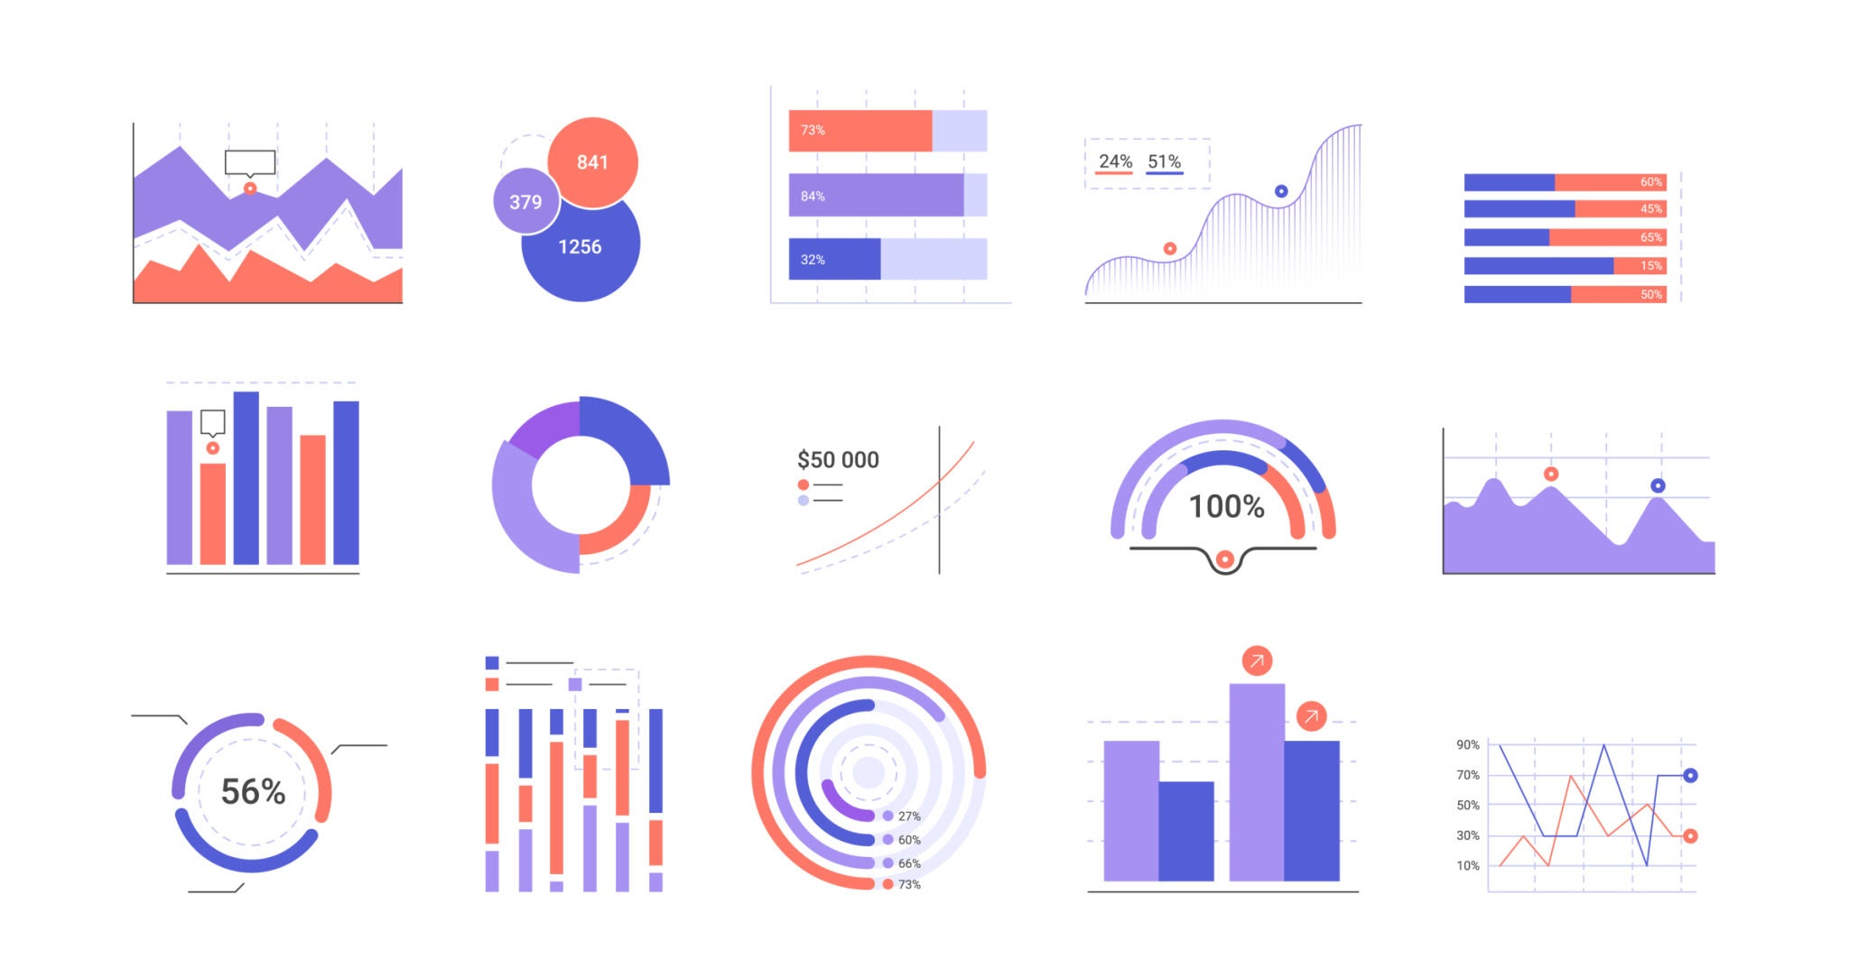

Data Understanding and Data Preparation
BREAK THROUGH TECH
Notes:
Shambhavi

Slide 13


Data Source
Market Price
Source: Yahoo Finance (via yfinance)
Daily OHLCV features:
Open, High, Low, Close, Volume
Rolling averages, volatility
Financial News
Source: Kaggle (financial news dataset)
Extracted features by Finbert from Prosus AI:
Average sentiment scores (positive / negative / neutral)
Number of headlines per day
Number of strongly positive headlines
Number of strongly negative headlines
Notes:
Shambahvi

Slide 14


Data Overview and Preparation
Dataset Overview: yfinance & Kaggle
Preprocessing: performed data cleaning and categorization
Visualization: Creating stock performance metrics
Notes:
Shambhavi

Slide 15
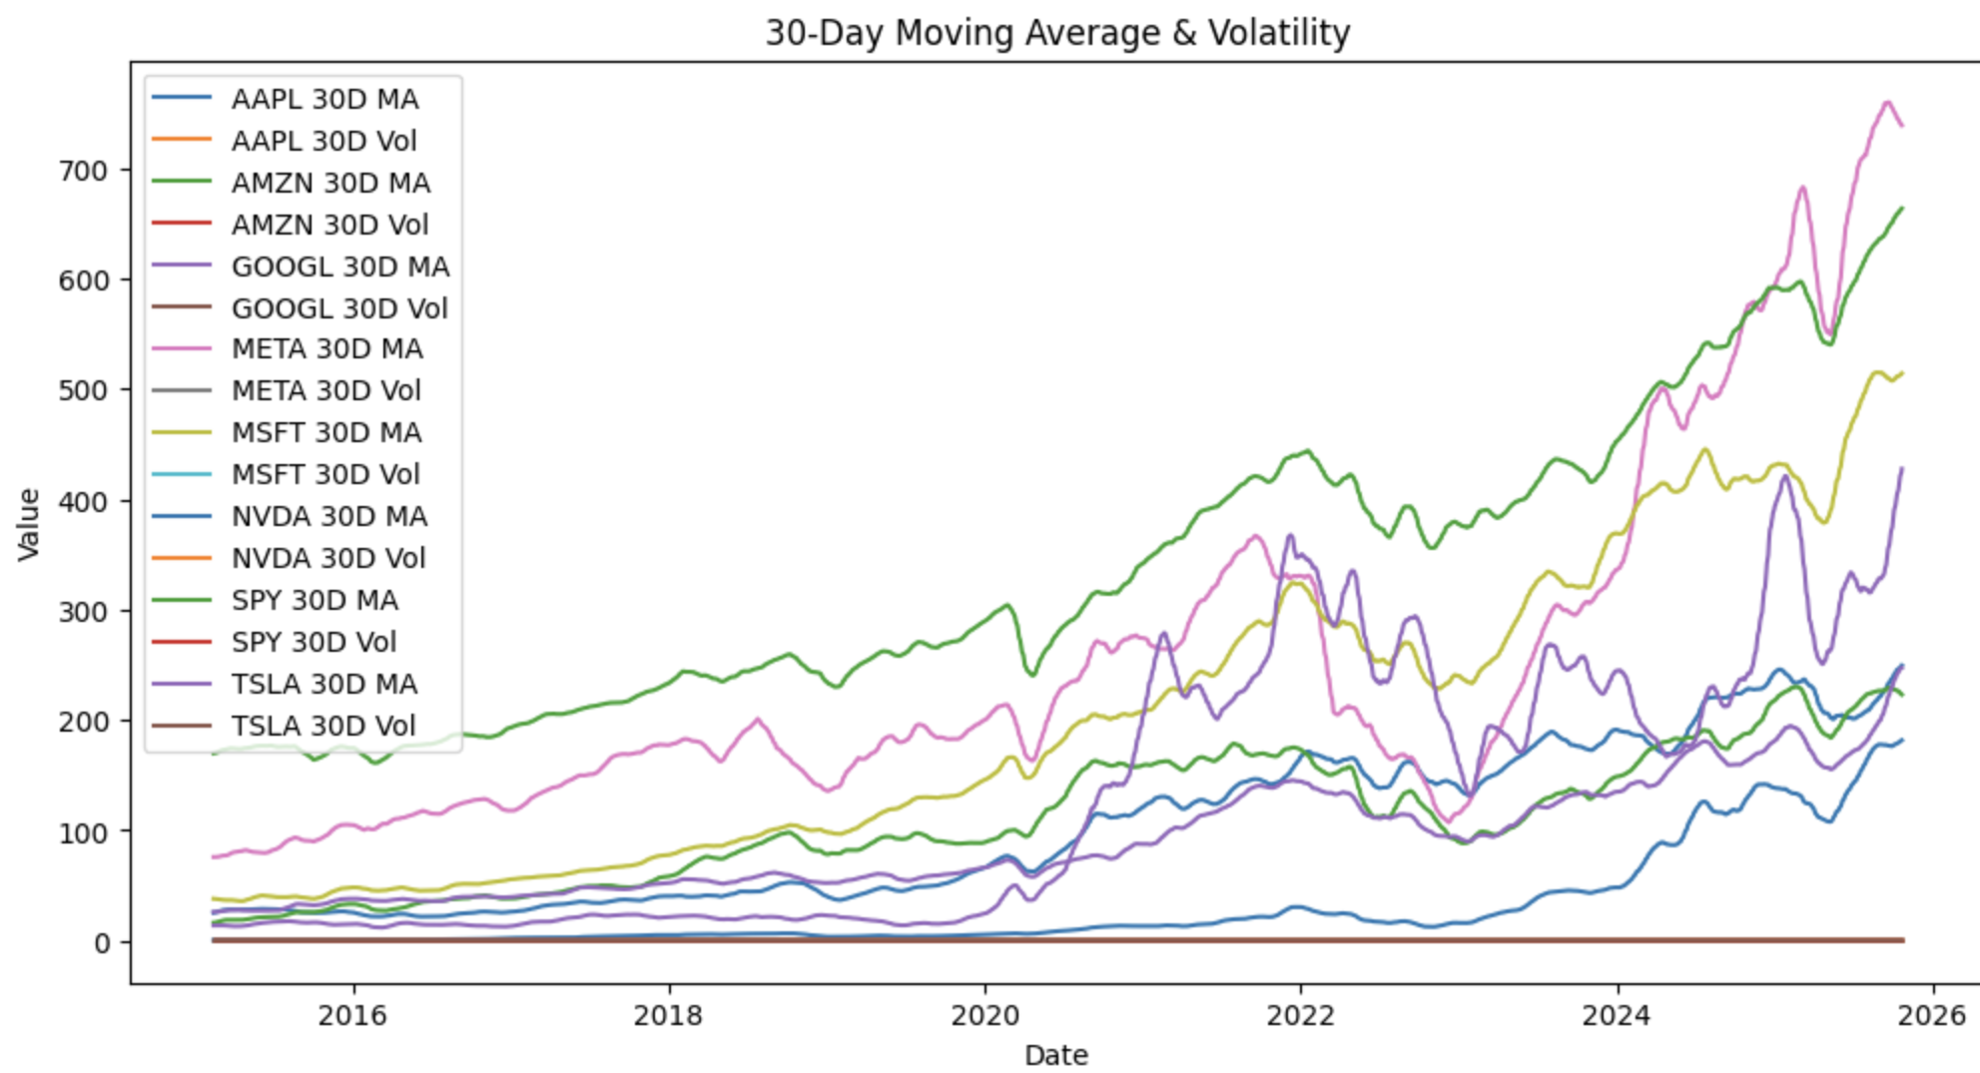
Data Visualization
Notes:
Shambhavi

Slide 16
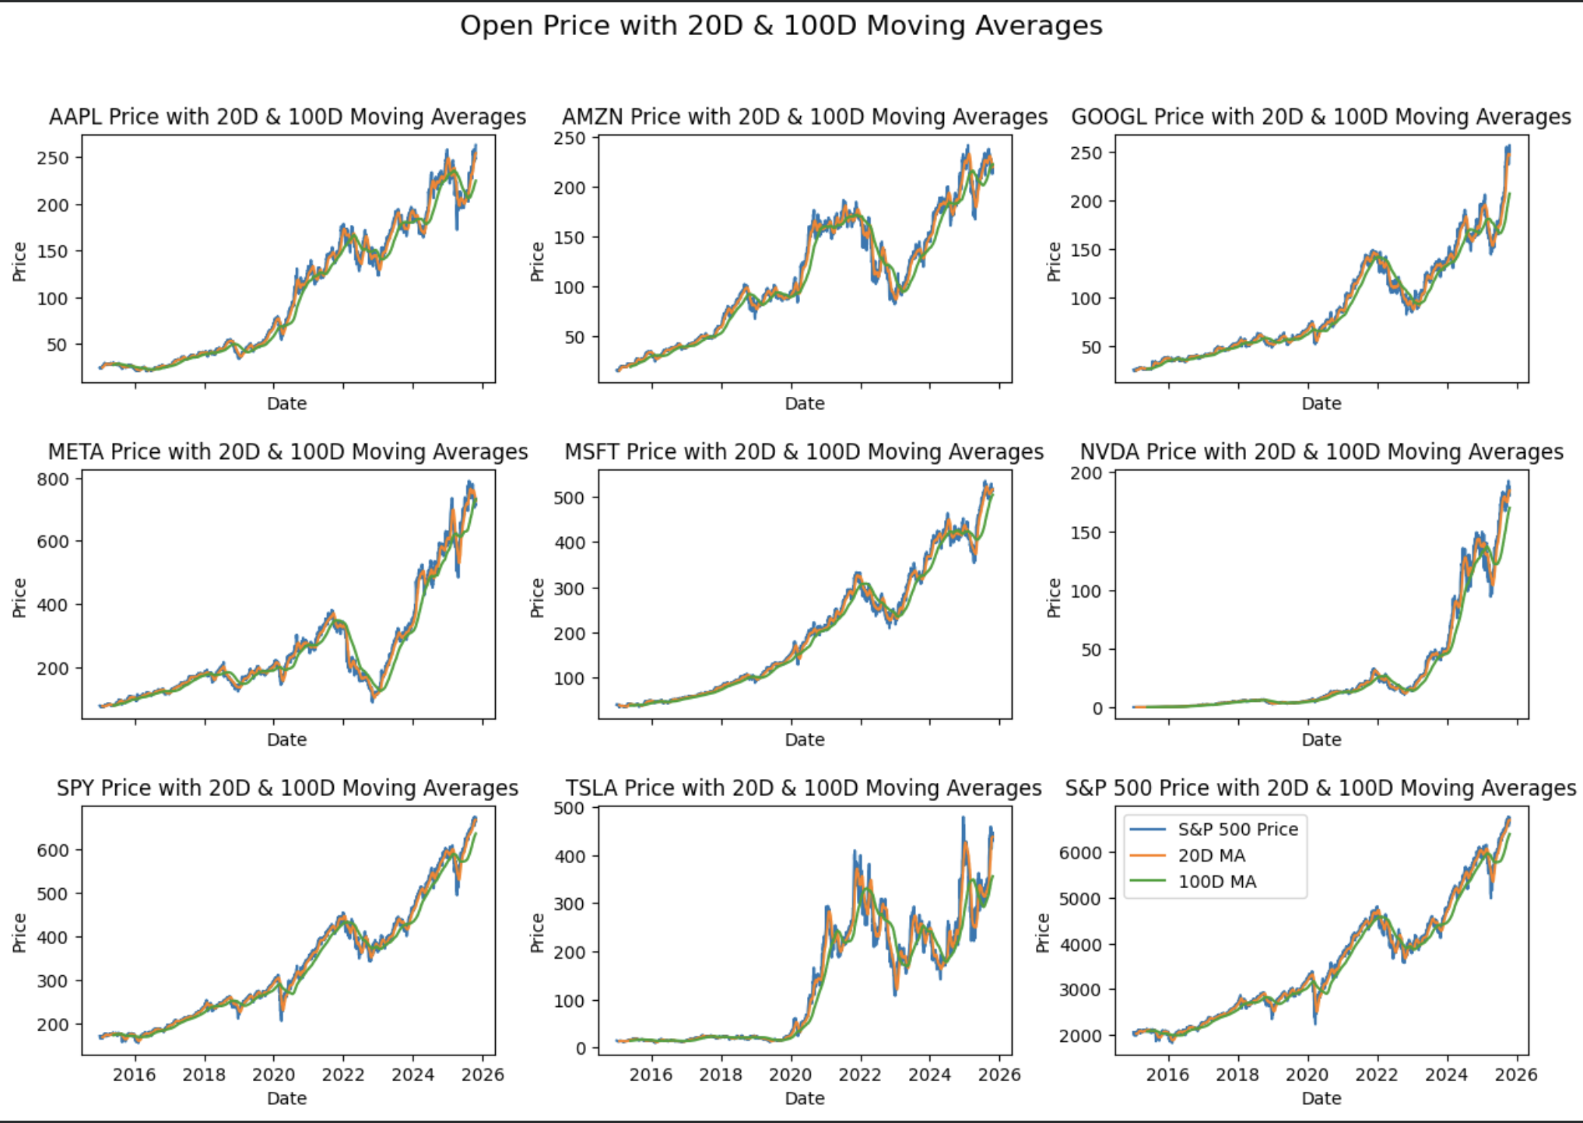
Notes:
Shambhavi

Slide 17
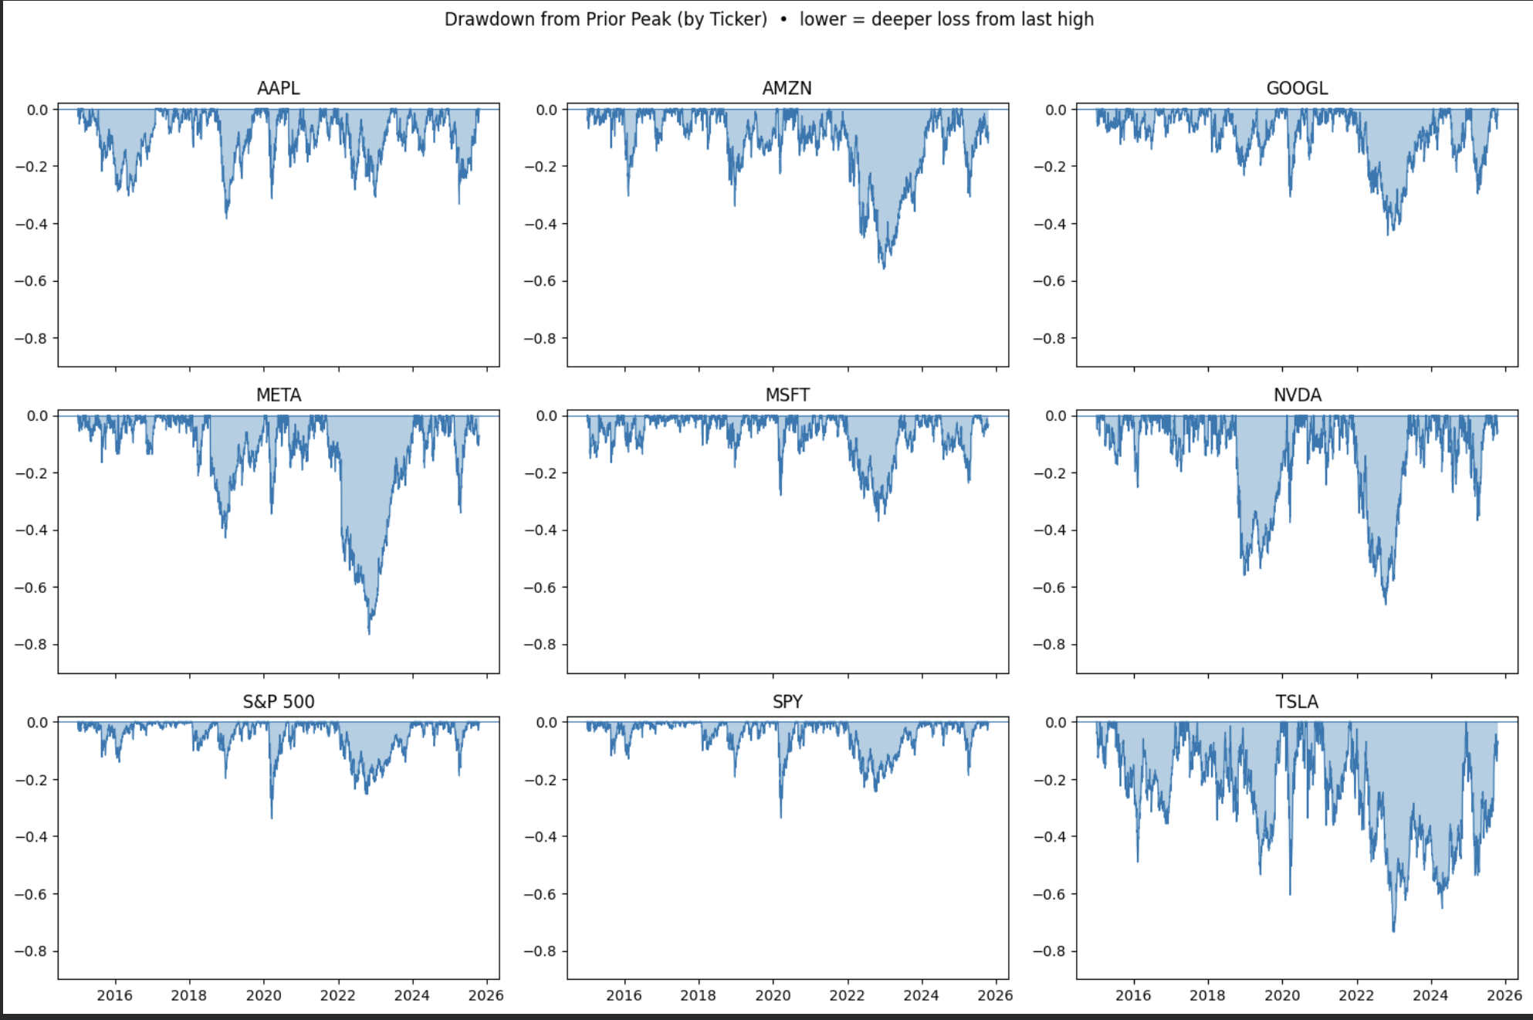
Notes:
Shambhavi

Slide 18
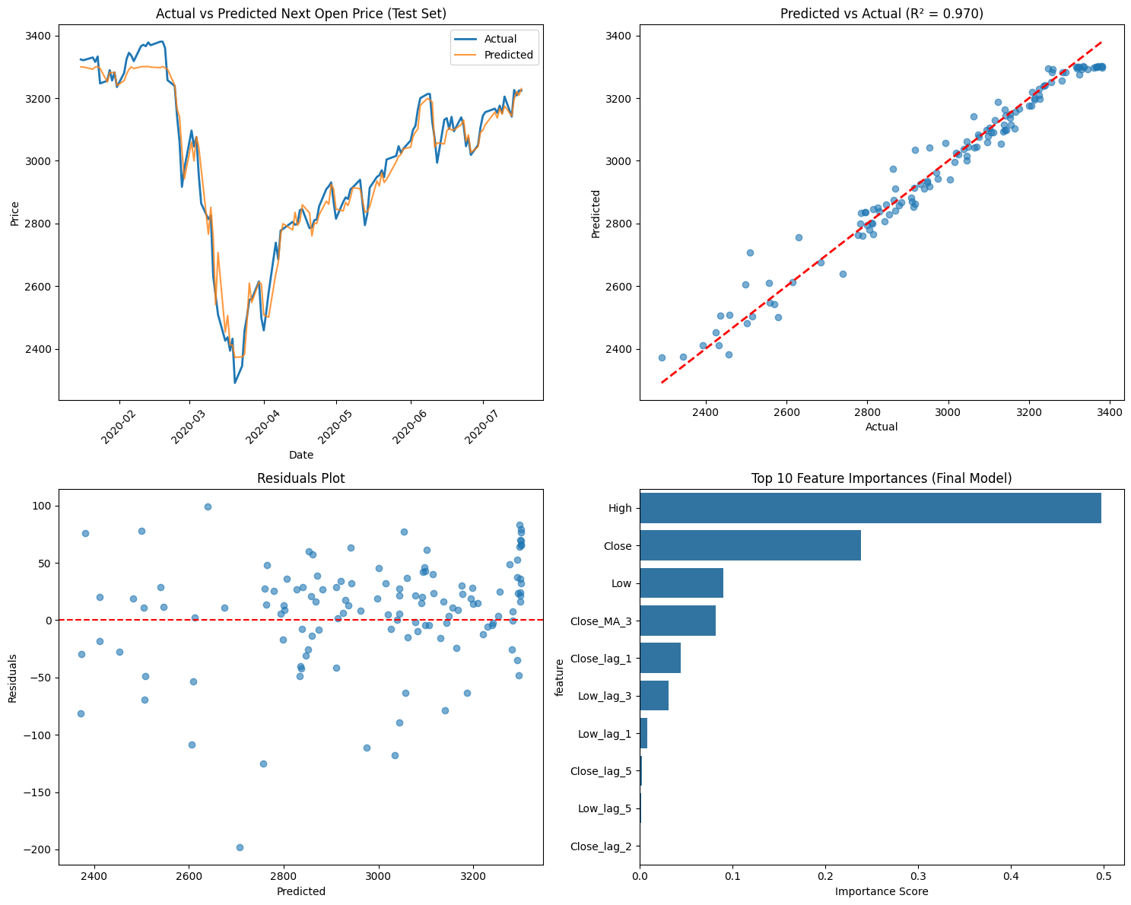
S&P 500 Prediction Choice
Represents the overall market
Less volatile than single stocks → more stable for modeling
Strong availability of historic price data and related news coverage
Notes:
Shambhavi

Slide 19
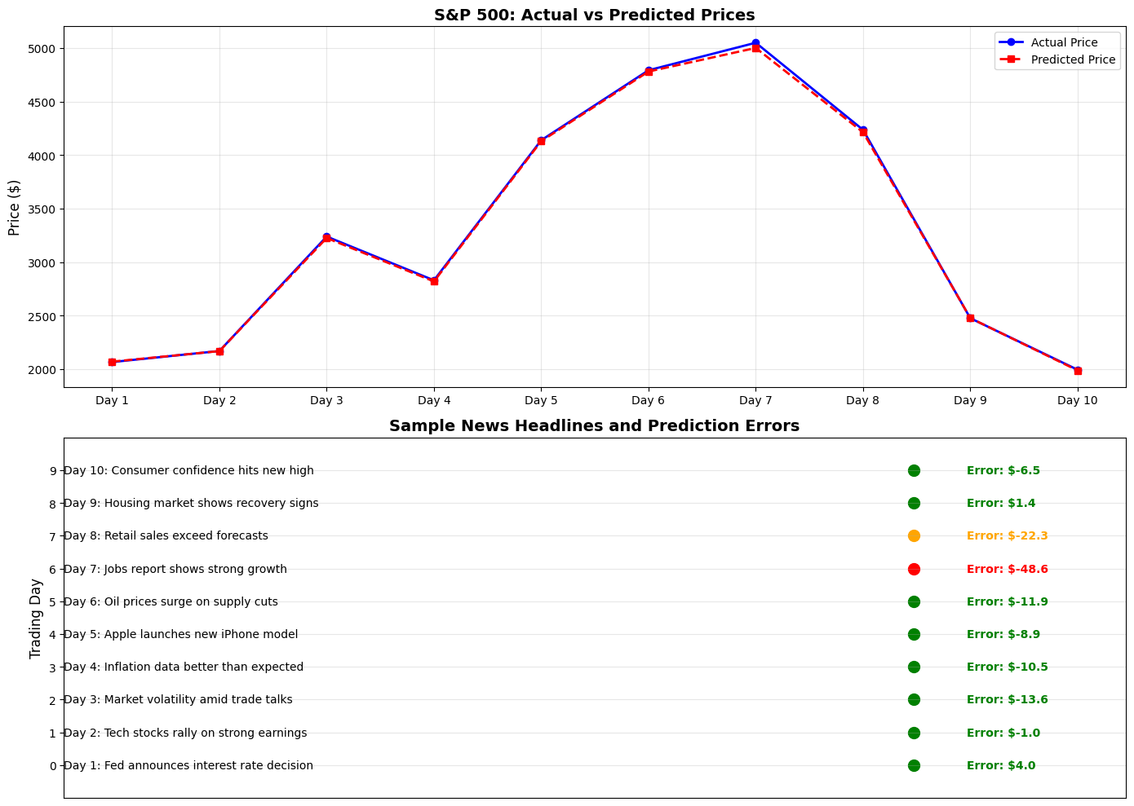
Notes:
Shambhavi

Slide 20

Modeling and Evaluation
BREAK THROUGH TECH
Notes:
Judy

Slide 21
Models Tested:
Lasso
Random Forest
XGBoost - Final model used
Notes:
Judy

Slide 22
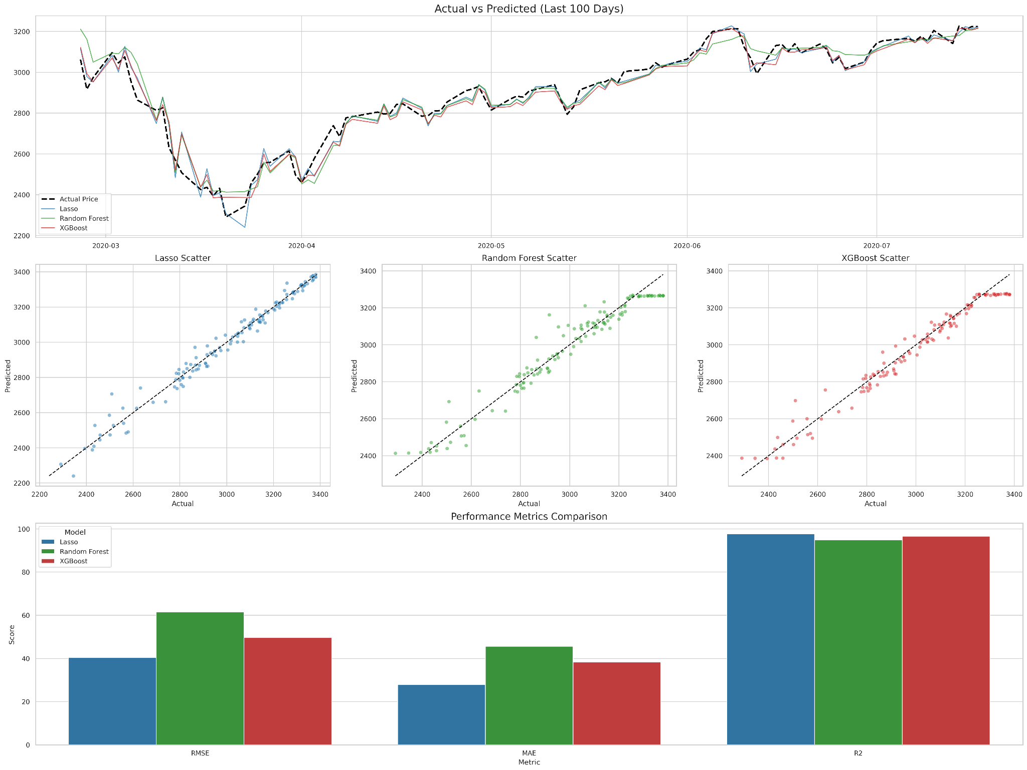
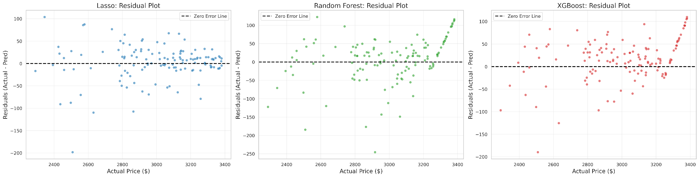
Lasso
Lasso regression shows a strong fit: predicted prices closely track actual prices along the 45° reference line.
Residuals are mostly centered around zero with no clear trend, indicating low systematic bias.
A few larger residuals suggest mild outliers, but they do not significantly affect overall model performance.
Notes:
Judy

Slide 23
Random Forest
Random Forest shows a generally strong fit, but predictions are slightly less tight around the 45° line than Lasso.
Residuals fan out at higher prices and become mostly positive, indicating the model tends to underpredict the most expensive observations.
The wider spread of residuals suggests Random Forest captures some non-linear patterns but still struggles with the upper end of the price range.
Notes:
Judy

Slide 24
Model Comparison
Model Name | Description | Results | Pros | Cons
Random Forest | Ensemble of many decision trees; captures non-linear patterns | Captured trend direction moderately well. Tended to underperform around volatile periods | Stable baseline, handles non-linear data, provides feature importance | Weaker than boosting models, smooth predictions, no time-dependency modeling
Lasso | Linear model with L1 penalty for feature selection | Strong linear fit: predicted prices track closely along the 45° line. Slightly wider spread at higher prices, but still stable. | Simple, easy to explain feature effects, fast to train and test | Cannot capture nonlinear relationships. Underperforms when price behavior depends on interactions or nonlinear market patterns.
XG Boost | A gradient-boosted decision tree model that builds trees sequentially, focusing on reducing previous errors. Widely used in financial ML due to its power and flexibility. | Best overall performance of all three models. Residuals show a mild underprediction for high-prices, but less severe than Random Forest. | Most accurate model in your experiment. Captures complex nonlinear price patterns well. | Less interpretable without SHAP. Slight over- and under-estimation in extreme price ranges.
Notes:
Judy

Slide 25
Demo for all the models we tested
Trading Profit Website
Notes:
Chris

Slide 26
XGBoost
XGBoost achieves a strong overall fit: most points lie close to the 45° line, indicating accurate price predictions.
Residuals are centered around zero for most of the range but fan out at higher prices and become mostly positive, showing that XGBoost tends to underpredict the most expensive cases.
A few mid-range observations show large negative residuals, suggesting occasional overreaction to local patterns and the presence of some outliers
Notes:
Chris Explain
Residuals become increasingly positive at higher actual prices, which means XGBoost tends to underpredict large price values
The main reasons:
Fewer training samples in the high-price region
Tree models cannot extrapolate beyond learned patterns
Rolling features lag during rapid price movements

Slide 27
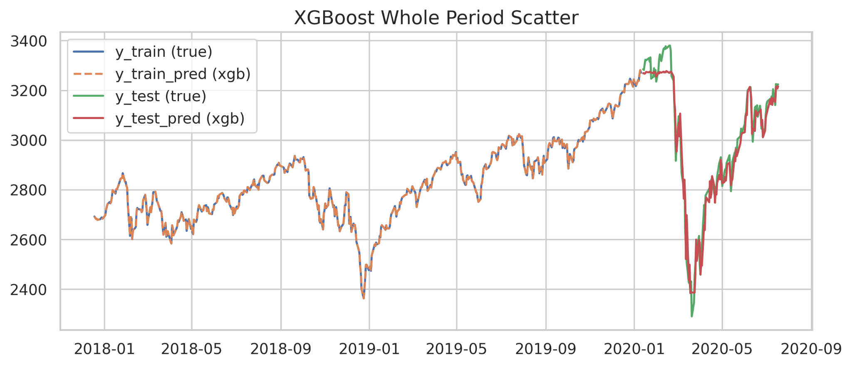
Notes:
Chris

Slide 28
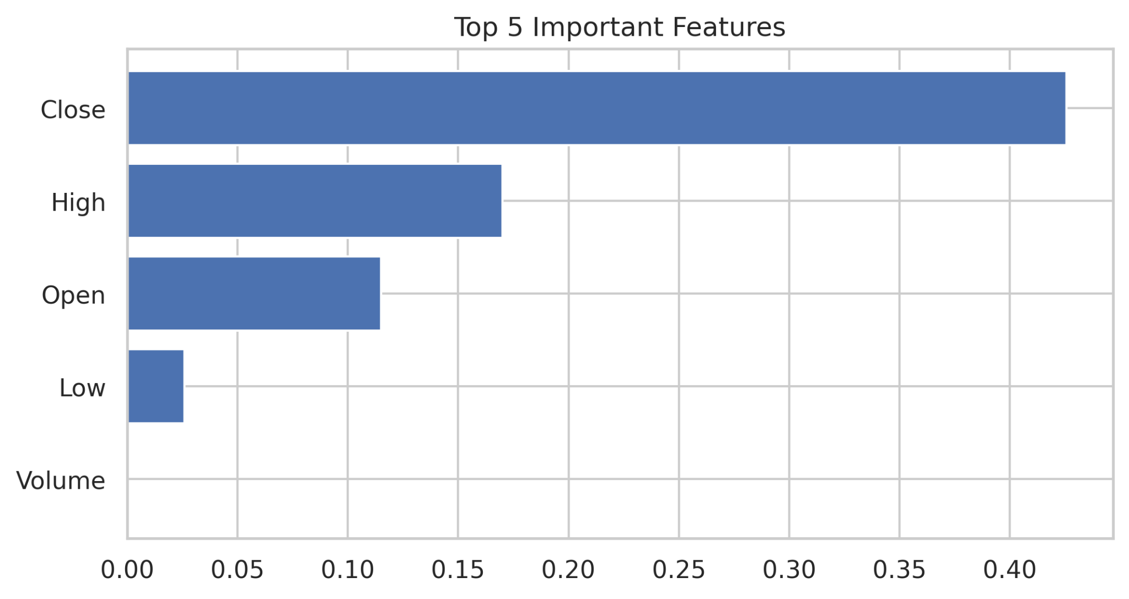
Notes:
Chris

Slide 29
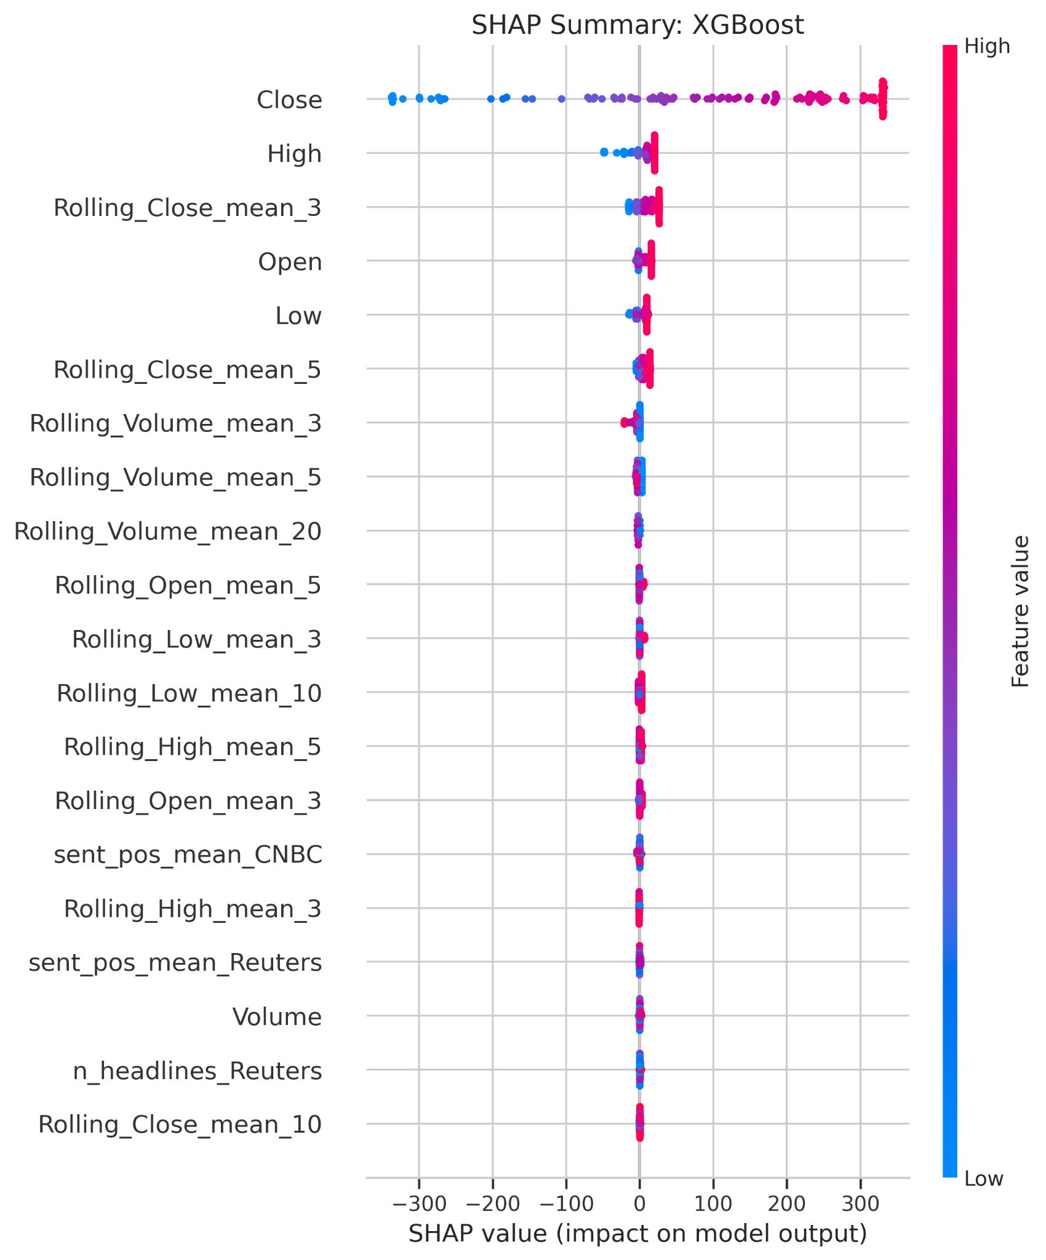
SHAP results show that XGBoost relies most heavily on recent price information: Close and High (plus short-horizon rolling close) have the largest and most variable impact on predictions.
High values of Close and High generally push predictions upward (red points on the positive SHAP side), while low values push them downward, matching financial intuition.
Volume- and news-related features (headlines, positive sentiment) contribute only modestly, indicating that XGBoost mainly uses price and short-term trend signals, with limited incremental value from text features.
Notes:
Chris

Slide 30
Across all error metrics, Lasso performs best: it has the lowest RMSE and MAE and the highest R², indicating the most accurate and stable predictions
XGBoost ranks second with slightly larger errors and a slightly lower R² than Lasso, but still clearly better than Random Forest.
Random Forest shows the highest RMSE/MAE and the lowest R², suggesting it fits the data less well than the other two models in this setting.
Notes:
Chris
165.67%

Slide 31
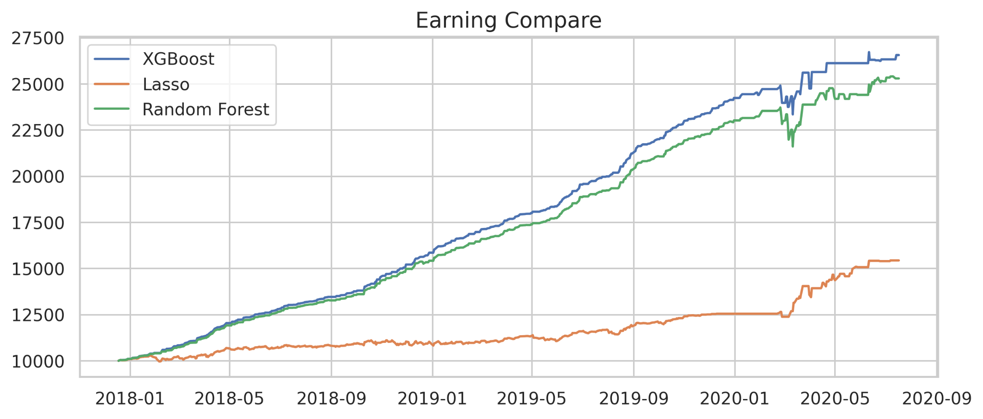
Notes:
Chris 165 %
Buy today, sell tmr

Slide 32
All three models closely track the actual price over the last 100 days, capturing both the downward dip in March and the subsequent steady upward trend.
The Lasso and XGBoost lines tend to stay closest to the dashed actual series, while Random Forest shows slightly larger deviations at some local peaks and troughs.
Short-term fluctuations are generally well reproduced, with only small lags or under/over-shoots during the sharpest moves.
Notes:
Chris

Slide 33
Final Model (XGBoost) Demo
Trading Profit Website
Notes:
Whoever is presenting/Judy

Slide 34

Final Thoughts
BREAK THROUGH TECH
Notes:
= NOTES =

Slide 35
Potential Next Steps
Possible data leakage We use day t’s close to predict day t+1’s open. Since these values are usually very similar, the model can “cheat” by relying heavily on Close, which SHAP confirms. This limits the model’s true predictive power.
Weak impact of news features News features contribute almost nothing, SHAP values are near zero. To make news meaningful, we may need a separate news model or a hybrid approach so news signals actually influence predictions.
Getting richer signals from text news We currently use simple sentiment averages. Future work could apply NLP methods—topic extraction, event detection, or text embeddings—to provide richer information than just positive vs. negative counts.
Notes:
Judy
We use day t’s close price to predict day t+1’s open price.
Because overnight moves are small, this makes the task almost “close ≈ next open”, which can cause data leakage.
SHAP also shows that Close dominates the models, so they rely too much on this almost-target feature.
Even though we add financial news variables, their SHAP values are near zero. To make news more useful, we may need a special “news block” or an ensemble that combines a price model and a news model, so news can really change the prediction instead of being a small extra feature.
Right now we only use simple counts and average sentiment.
In the future we can use NLP to extract events, topics, and better sentiment from raw articles, or build embeddings of the text, so the models see more detailed information than just “how many positive headlines”.

Slide 36

What We Learned
Technical skills: preprocessing, data cleaning, model fine-tuning, sentiment analysis integration, model evaluation
Professional Skills: teamwork, project management, time management
Acknowledgements: Leah and Atena
Notes:
Karla

Slide 37


Thank you!
Questions?
BREAK THROUGH TECH
Notes:
Judy

